Slide 1
3a. Experiment and Develop Model
Notes:
As of 2/21/2020

Slide 2
Meeting Agenda
Topic | Time | Presenter
Feature Store | 30 mins | Nara
Mlflow | 45 mins | Jake
Model Registry | 20 mins | Nara
HyperOpt | 20 mins | Jake
Feature Selection SDK | 15mins | Lanhui
Autogluon SDK | 15mins | Lanhui

Slide 3


Meet the Team
To add or arrange timeline elements, manually move and edit text group.
NOTE
Name
Pronoun1/2/3
Job Title
Name
Pronoun1/2/3
Job Title
Name
Pronoun1/2/3
Job Title
Name
Pronoun1/2/3
Job Title
Name
Pronoun1/2/3
Job Title
Name
Pronoun1/2/3
Job Title
Name
Pronoun1/2/3
Job Title
Name
Pronoun1/2/3
Job Title

Slide 4
Feature Store

Slide 5
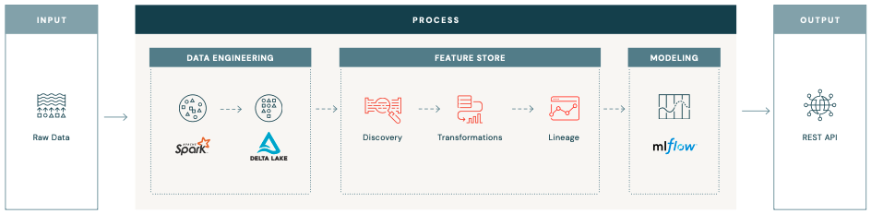
What is a feature store?
Feature Store consists of a feature catalog for discovery and collaboration, and feature provider to serve features in batch, streaming or low latency online deployments.

Slide 6







Feature Engineering
Separation between Feature Computation and Feature Encoding
INPUT
FEATURE ENGINEERING
MODEL PIPELINE
OUTPUT
Model Serving
Raw Data
Feature Computation
Feature Table
Feature Encoding and
Model Training
Model Lineage
and
Tracking
Online Feature Store
Domain specific, consist of analytically defined (aggregated) calculations which can either be applied at a single or group feature level:
Statistics (i.e. count/min/max, sum)
Aggregations of raw data over time windows (i.e.: weekly moving average)
Joined combinations of data sets (i.e.: customer demographic information joined to transaction features)
Domain specific/closed-loop formulas
…
Domain agnostic, consist of generic transformations, calibrations and best practices applied to features values to make them machine “readable”:
Categorical encoding (i.e. OHE, label encoding…)
Numerical scalers (i.e. minmax, power transform…)
Feature interaction
…

Slide 7


Feature Computation Modes
Pre-computed
On-demand
Computed ahead of time (batch and/or stream) and stored in a table (i.e. a Feature Store), ready for training and inference/serving pipelines.
Availability, Computation, or Fetching can only happen in real time based on other feature(s) or look-up key(s).

Slide 8


Data Freshness vs. Data Latency
Freshness
Latency
Time taken for:
Raw data to organically get updated (natural pace of change… of underlying raw/bronze/silver tables)
+
Computing and delivering fresh data to offline/online store and/or model inference end-point
Time to lookup feature value from online store
Low-latency serving requires to push feature values to an online store

Slide 9
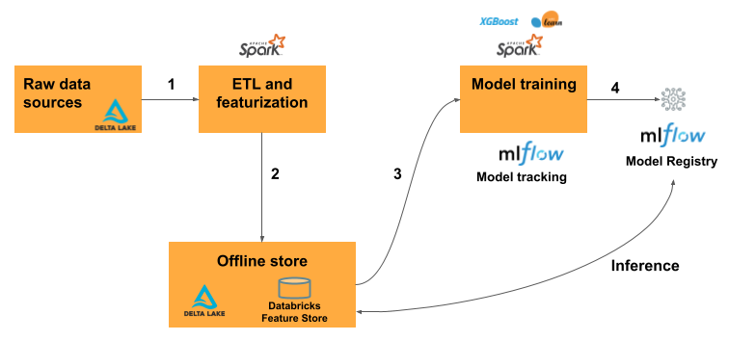
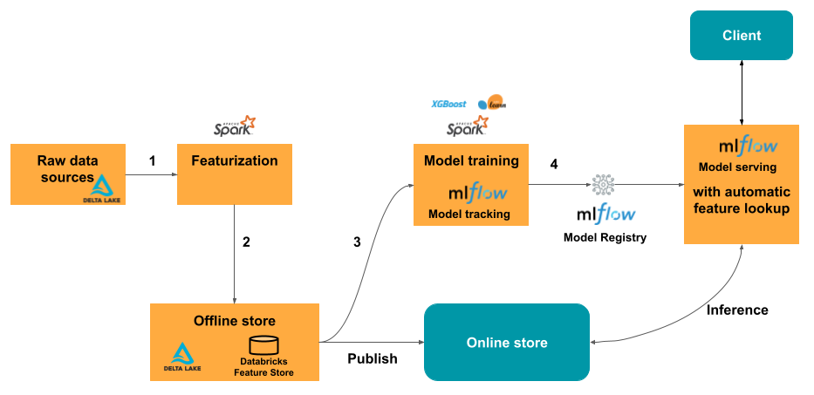
Feature Store Types
Offline store
Online store
Used for the storage and retrieval of historical data. It is also used for model training and batch scoring.
Low-latency database used for serving the latest features for model prediction.

Slide 10








ML Development Lifecycle
Raw Data
Featurization
Training
Serving
Client
Joins, Aggregates, Transforms, etc.
csv
csv
Notes:
So to start off, let’s take a look at what the typical machine learning development lifecycle looks like:
Data scientists grab raw data and iteratively perform featurization. Often times, due to the necessity to rapidly iterate on models, data scientists take the most expedient path, such as copying code from Stackoverflow, to transform their data into the right features. As a result, features are not easily discoverable and reusable, and when a Data Scientist moves onto developing a new model, this whole process is repeated, even if the features are almost identical.
Once the model has been created, tested and approved - the resulting code and models are given (thrown over the brick wall) to data engineers to implement a scalable pipeline for serving and integrating into applications for consumption. Often times the data engineers won’t have much context into the models and the new data requirements for the models that the data scientists are moving on to.
Once they have created one model, they move onto the next model and repeat the exact same process - with minimal reuse and a lot of manual hand-offs
As such, Data engineers, data scientists and ML engineers spend an inordinately large amount of time transforming data from its raw form into the final “features” that can be consumed by ML models.

Slide 11
Feature Development
Challenge #1: No Reuse of Features
Raw Data
Featurization
Training
Joins, Aggregates, Transforms, etc.
csv
csv
No Reuse of Features
Notes:
This brings us to the first of two feature development challenges - No reuse of features
In most cases, features get reimplemented several times because they are not discoverable, and if they are, they are not managed in a way that facilitates reuse. This happens for a couple of reasons:
Naive approaches to this problem provide search based on feature names, which requires data scientists to correctly guess which names someone else used for their features.
Data scientists have no way to know which features are used where, making decisions such as updating or deleting a feature table difficult.
See here for more info

Slide 12
Feature Development
Challenge #2: Online/offline skew
Raw Data
Featurization
Training
Serving
Client
Joins, Aggregates, Transforms, etc.
csv
csv
need to be equivalent
Notes:
The second of two feature development challenges is something called - Online/offline skew
This can be defined in the subtle differences in features that were used to train models vs. what’s used in production. Take the example below as an explanation for why this happens:
For some of the most meaningful ML use cases, models need to be deployed online at low latency (think of a recommendation model that needs to run in tens of milliseconds when a webpage loads). The transformations that were used to compute features at training time (offline) now need to be repeated in model deployment (online) at low latency. This often leads teams to reimplement features multiple times, introducing subtle differences (called online/offline skew) that have significant impact on the model quality.
For example, we might have trained a fraud model using a set of features, however when implementing we noticed that a certain feature (such as IP Address) was allowing instances of schema mismatches. So we quickly change the pipeline that feeds the model, without retraining the model - leading to slight differences in the data that feeds the online model and the data that was used for training the algorithm.
A secondary challenge of online/offline skew, is the difficulty of tracking down the features that were used to train the initial model. As the model code is iteratively worked on, the underlying data is often not versioned to keep track of the features used for model experimentation. The same often happens in the reverse, as the data pipelines are iteratively worked on, the underlying model stays static and not versioned to track experiments. As such, it’s very difficult to track down the most successful experiments and understand the entire lineage of your most accurate models.
See here for more info

Slide 13



Why would you need a feature store?
Basic Motivations
Discovery
Multiple Data Scientists are trying to solve similar modeling tasks and come up with different definitions of the same features. How can I find the features?
Lineage
Model governance requires documentation of the features used to train a model, as well as the upstream lineage of a feature to reliably use it. How is it computed, and who owns it?
Skew
When multiple teams manage feature computation and ML models in production, minor yet significant skew in upstream data at the input of a feature pipeline can be very hard to detect and fix.
Online Serving
During exploration and model experimentation phases features are implemented in frameworks that do not scale to production.

Slide 14















Feature Store
The first Feature Store codesigned with a Data and MLOps Platform
Data Science Workspace
AutoML
Data
Prep
Model Training
Model Tuning
Runtime and Environments
Batch Scoring
Online Serving
Data Versioning
Feature Store
Batch (high throughput)
Monitoring
Real time (low latency)
MLOps / Governance
Open Data Lakehouse Foundation with
Notes:
This is where the Databricks feature store operates within the greater ecosystem of Databricks ML. As you can see, it’s just a small puzzle piece of the greater suite of tooling built to solve the challenges of ML development and deployment. However, today we will focus on how powerful this tool is and how you can use the feature store to accelerate your ML development lifecycle.

Slide 15

Feature Store High-Level Architecture
Feature Definitions
This steps records the metadata associated with the feature table.
In order to control the location the data will be stored it is required to set the LOCATION during the database creation, otherwise the schema and the tables are going to be created in the default warehouse directory, whose path is configured by the static configuration spark.sql.warehouse.dir.
Flexibility in feature definition
Performance attributes based on language choice
Feature 1
Feature 2
create_table()

Slide 16

Feature Store High-Level Architecture
Feature Definitions
Feature Tables
For reproducible machine learning training, you can log a time stamp as an MLflow parameter and use time travel when loading the data.
By default you can time travel to a Delta table up to 30 days. Therefore, for reproducibility, either create a DEEP CLONE or increase the retention period for the delta table.
Flexibility in feature definition
Performance attributes based on language choice
SQL tables that can be queried from any language
ACLd, versioned, and optimized for performance
Feature 1
Feature 2
Customer Features
write_table()
create_feature_table()

Slide 17







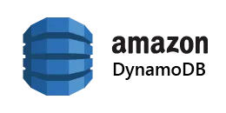
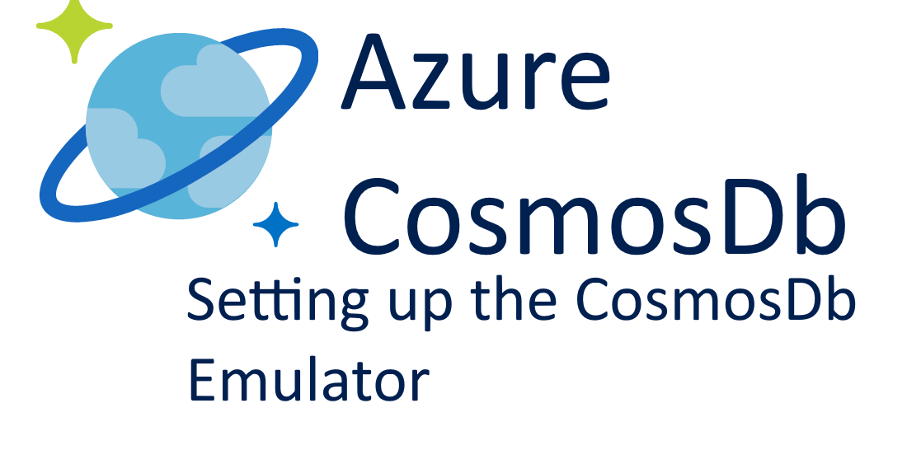
Feature Store High-Level Architecture
Feature Definitions
Feature Tables
Training Data Set Creation
Flexibility in feature definition
Performance attributes based on language choice
SQL tables that can be queried from any language
ACLd, versioned, and optimized for performance
Feature 1
Feature 2
create_training_set()
Batch Scoring
read_table()
Customer Features
write_table()
publish_table()
Online Serving
create_feature_table()
Model Serving
REST Endpoint

Slide 18






Feature Computation
Feature latency requirements
< 1 second (*)
seconds
minutes
hours
Embedded
Realtime
Stream
Batch
Client/Edge computation
On-demand computation
Streaming
computation
Batch computation
Native code
(*) Scenarios where client/edge computation is preferred or mandatory:
Minimize volume in transit (data reduction)
Privacy concerns
Restricted (server side) network connectivity
Notes:
Edge: Faster to compute with real-time OS (C/C++)
The conservative boundary between on-the-fly and streaming computation is around 15-20 secs for more complex type of computation.

Slide 19
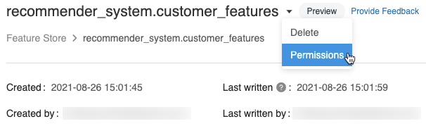
Feature Governance
Metadata
Data
Feature Store metadata are governed by Feature Store ACLs, with the options:
Can View Metadata
Can Edit Metadata
Can Manage
Underlying data (Delta tables) are governed by Table ACLs, with the options:
SELECT
CREATE
MODIFY
USAGE
READ_METADATA
ALL PRIVILEGES
Notes:
Edge: Faster to compute with real-time OS (C/C++)
The conservative boundary between on-the-fly and streaming computation is around 15-20 secs for more complex type of computation.

Slide 20
Feature Store Best Practices
Understand the Purpose of a Feature Store: A feature store is a data management tool designed to make features portable and reusable. It helps to manage the skew between the inference and training environment in machine learning models.
Identify the Primary Key: Feature tables need a primary key to identify how to join the features. The values must be associated with something uniquely identifiable.
Distinguish Between Raw Data and Features: Not all data related to data science and machine learning should be managed in a feature store. A feature store adds value in managing transformed data suitable for direct use in a machine learning model, not the raw data that is being transformed.
Understand the Role of a Feature Store in an Architecture: A feature store manages features, or data, but its task depends on several related concerns such as data storage, feature production, source data access, and model requirements at both training and inference time.
Consider Runtime Inputs vs Precomputed Inputs: Depending on how models are used, it might make sense to store certain data as a feature.
Ensure Feature Quality Control: To ensure quality, feature owners need to implement controls, and feature consumers need to be able to see information about quality. This can be done by setting up a Databricks Job which uses Apache Spark and Delta to read and write data.
Use Feature Store for Collaboration and Discovery: Feature Store consists of a feature catalog for discovery and collaboration, and a feature provider to serve features in batch, streaming, or low latency online deployments.
Separate Feature Computation and Feature Encoding: Feature engineering involves domain-specific calculations and domain-agnostic transformations. These should be handled separately for better management and efficiency.
Consider Feature Computation Modes: Features can be computed ahead of time (batch and/or stream) and stored in a table (i.e., a Feature Store), ready for training and inference/serving pipelines. Alternatively, availability, computation, or fetching can only happen in real time based on other feature(s) or look-up key(s).
Implement Feature Governance: Feature Store metadata are governed by Feature Store ACLs, with options like "Can View Metadata", "Can Edit Metadata", and "Can Manage". This helps in maintaining the integrity and security of the feature data.
Notes:
Edge: Faster to compute with real-time OS (C/C++)
The conservative boundary between on-the-fly and streaming computation is around 15-20 secs for more complex type of computation.

Slide 21
MLflow

Slide 22

Databricks Machine Learning
A data-native and collaborative solution for the full ML lifecycle
Data Science Workspace
AutoML
Data
Prep
Model Training
Model Tuning
Runtime and Environments
Batch Scoring
Online Serving
Data Versioning
Feature Store
Batch (high throughput)
Monitoring
Real time (low latency)
MLOps / Governance
Open Data Lakehouse Foundation with

Slide 23












Tracking
Notebooks
Tracking Server
UI
Local Apps
API
Parameters
Metrics
Artifacts
Cloud Jobs
Metadata
Models
Spark
Data Source

Slide 24

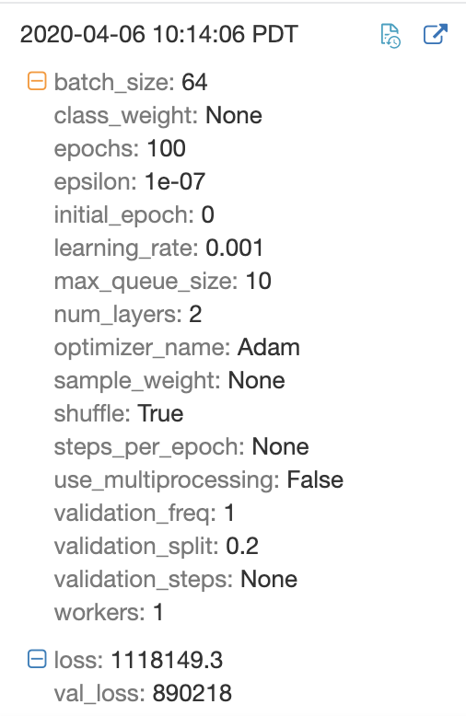
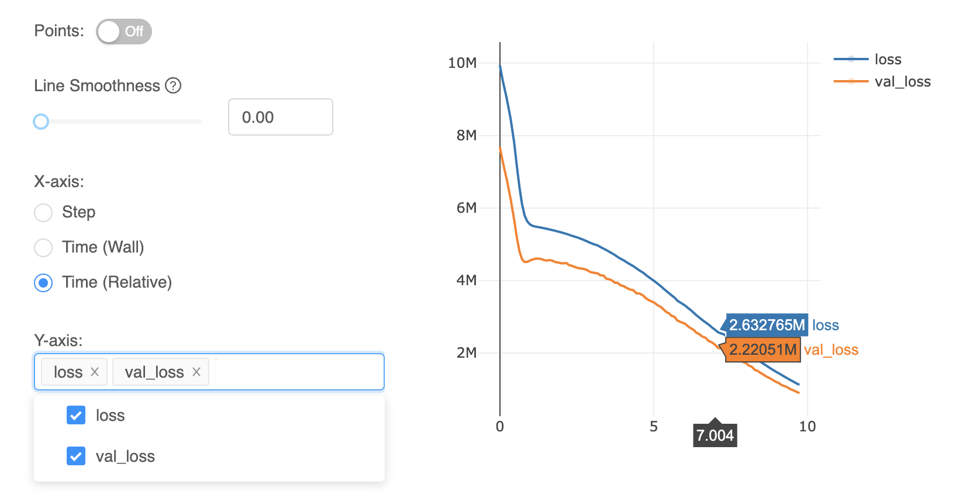
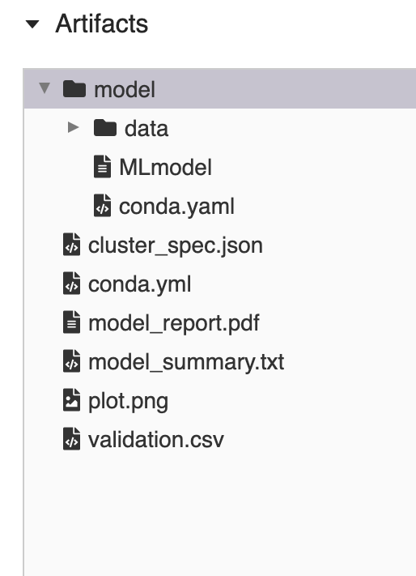








Tracking
Models
Parameters
Artifacts
Metrics
Experiment Tracking
Powered by

Slide 25
Example MLflow Model
my_model/ ├── MLmodel │ │ │ │ │ └── estimator/ ├── saved_model.pb └── variables/ ...
run_id: 769915006efd4c4bbd662461 time_created: 2018-06-28T12:34 flavors: tensorflow: saved_model_dir: estimator signature_def_key: predict python_function: loader_module: mlflow.tensorflow
Usable by tools that understand TensorFlow model format
Usable by any tool that can run Python (Docker, Spark, etc!)

Slide 26
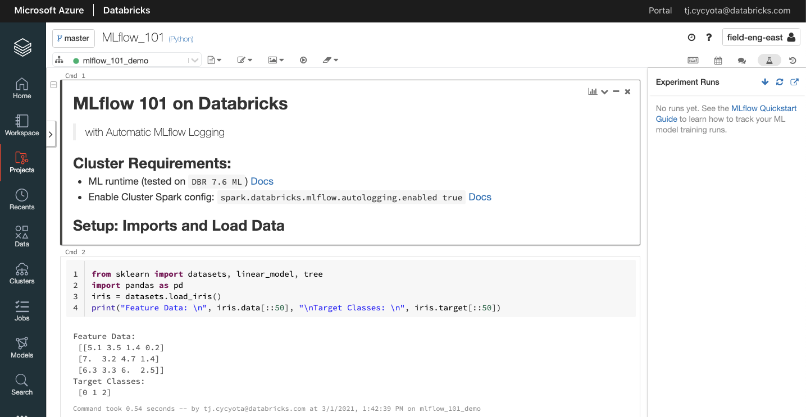
1. Setup
Attached to 7.6+ ML cluster with autologging enabled
No runs in Experiment sidebar yet
Iris dataset from scikit learn (intentionally a “toy problem” and not dependent on databricks-datasets)
Note that we’re not importing MLflow; it is automatically there for us with auto-logging

Slide 27
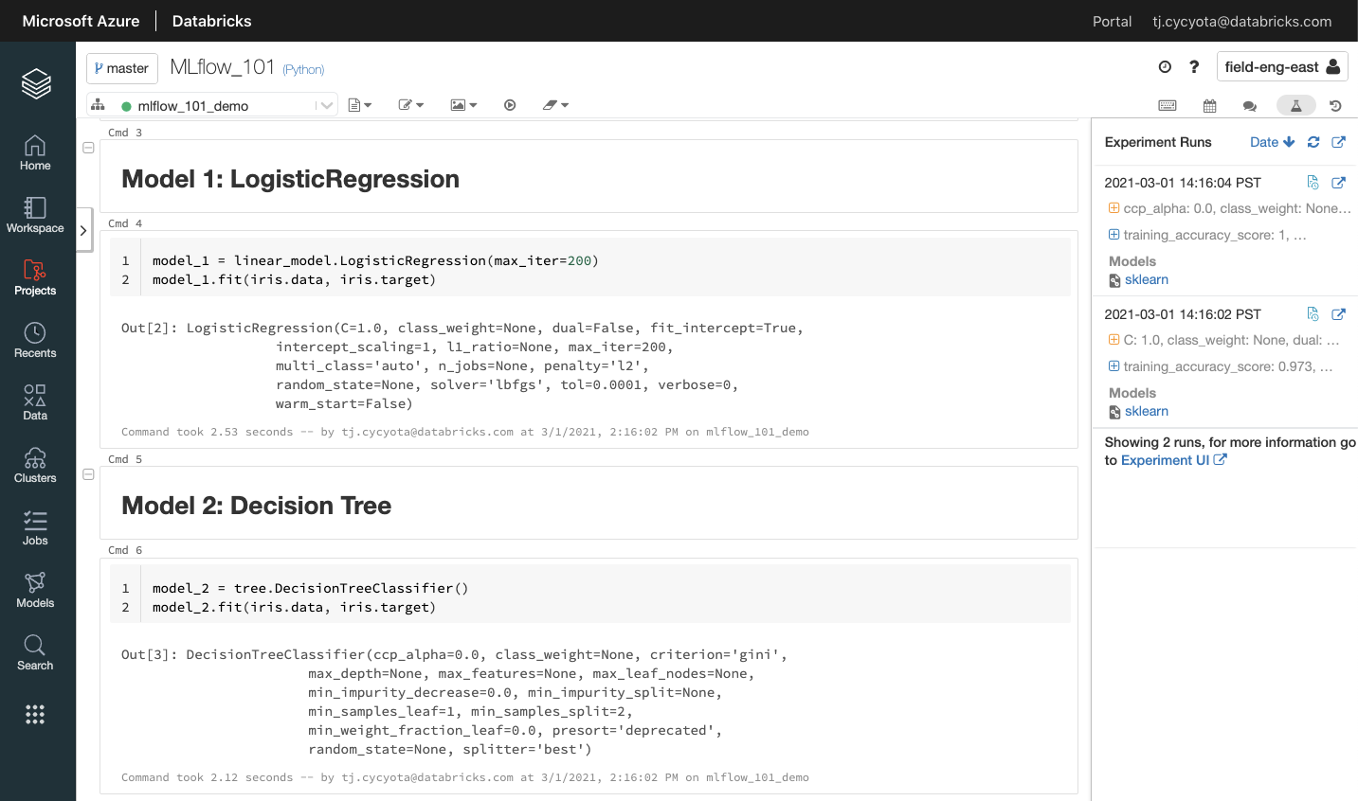
2. Train Basic Models
Runs automatically appear in sidebar with default hyperparams and a snapshot of training metrics
Simple model 1: Logistic Regression from Scikit learn
Simple model 2: Decision Tree from Scikit learn
Go into MLflow UI

Slide 28
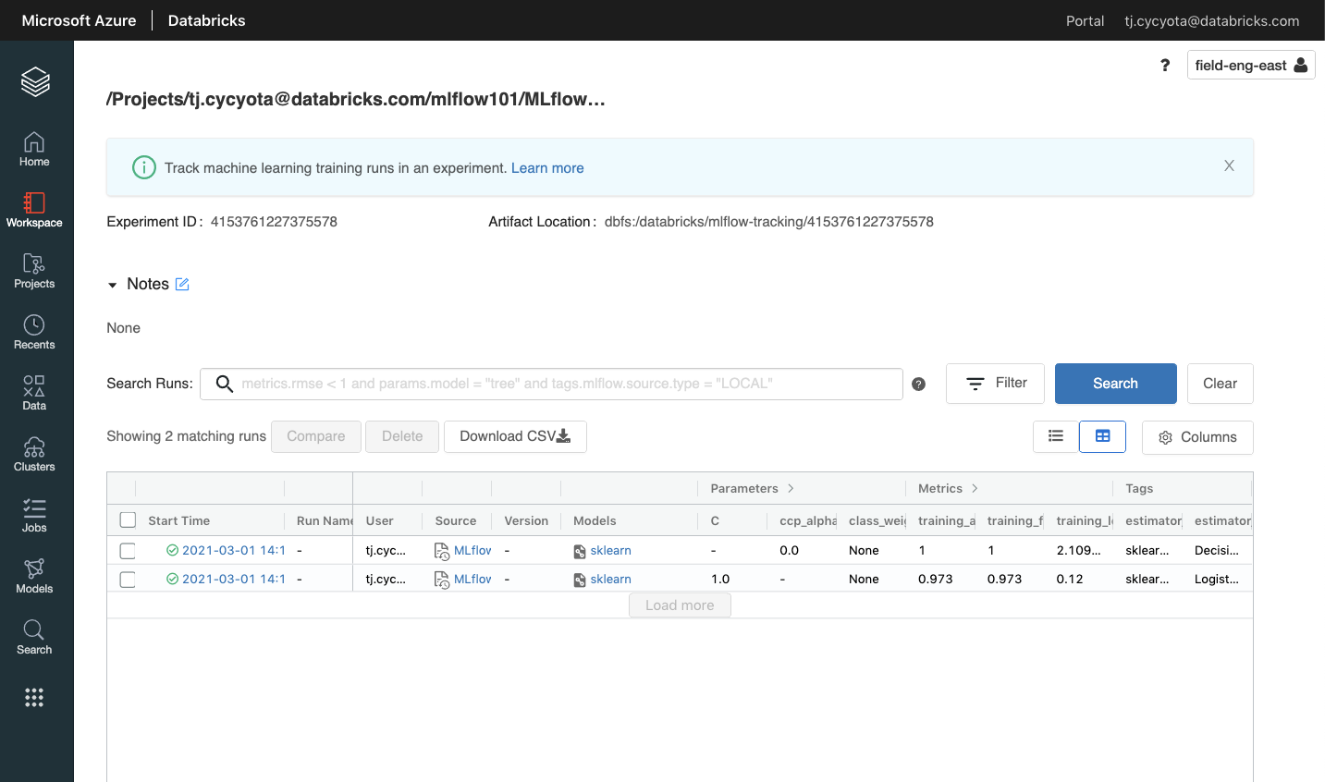
3. Experiment UI
This experiment “linked” to a notebook, but can create standalone experiments too
Each experiment has an ID and location where files are stored
Will hundreds or millions of runs, you can filter and search too!
Use Markdown to provide details, annotate, comment, etc
CLICK into one of the Runs
Tabular view of all Runs, interactive view to see inputs, outputs, tags, etc.
All of these are the defaults for now

Slide 29
3. Experiment UI
This experiment “linked” to a notebook, but can create standalone experiments too
Each experiment has an ID and location where files are stored
Will hundreds or millions of runs, you can filter and search too!
Use Markdown to provide details, annotate, comment, etc
CLICK into one of the Runs
Tabular view of all Runs, interactive view to see inputs, outputs, tags, etc.
All of these are the defaults for now

Slide 30
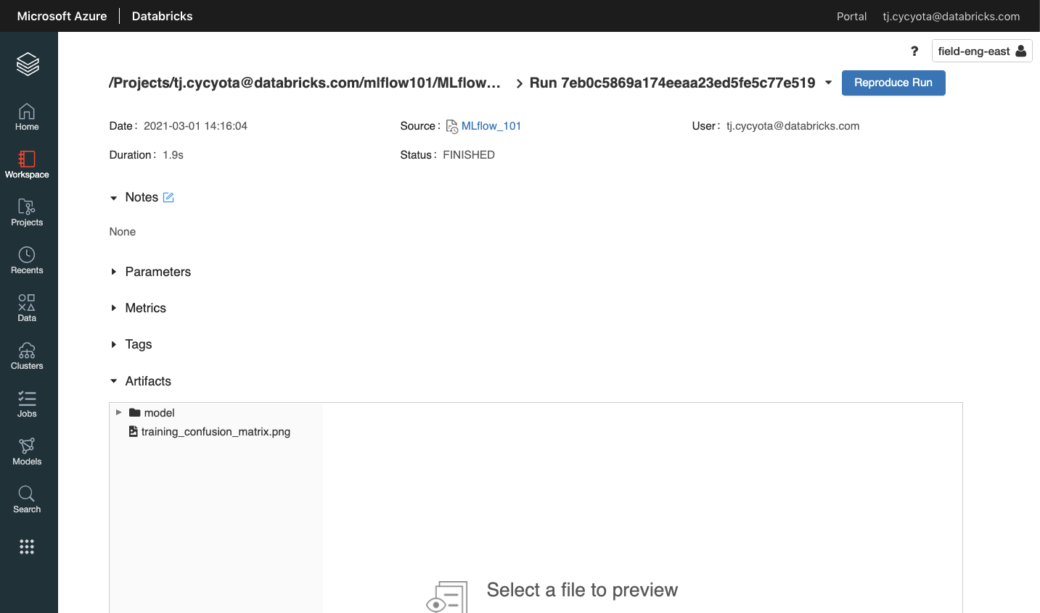
4. Runs UI
Each run is tracked with metadata and information useful for governance (including link back to source code that generated run)
Expand each and explain that these are tracked automatically; they can also be customized
Artifacts are any “file” associated with your run. E.g. model files, or any arbitrary file you want to keep track of

Slide 31
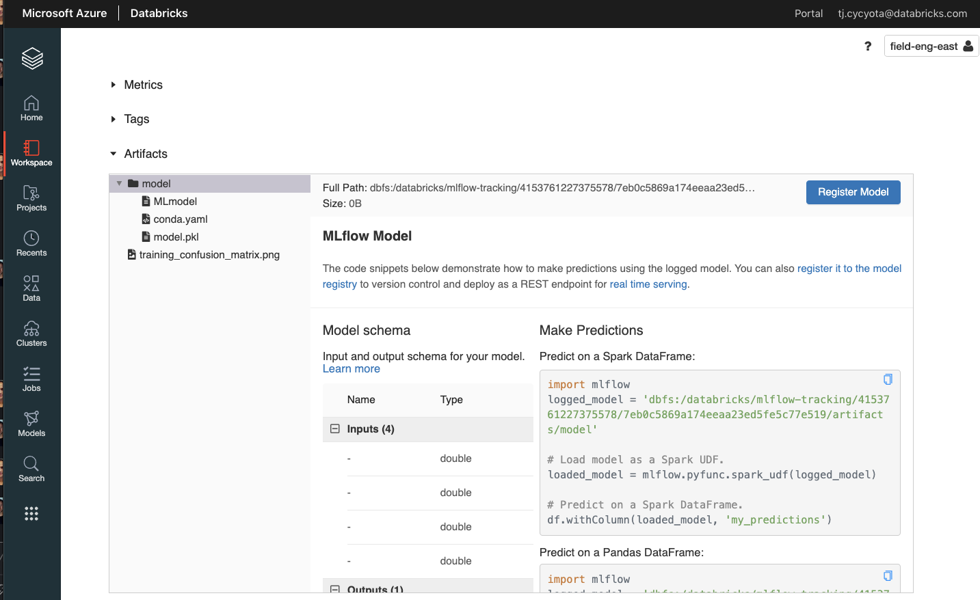
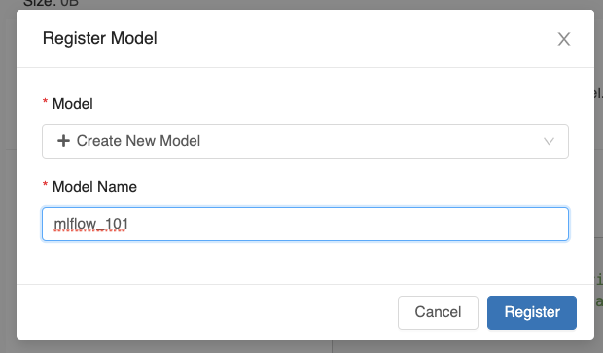
5. Register Model
Click model; MLflow components are there, including environment information that makes this reproducible
CLICK to Register model in model registry
Create a new model, or add to an existing one. CLICK register, then “expand” link next to spinning registering icon
The input and output schema are tracked, so you know what this model expects

Slide 32
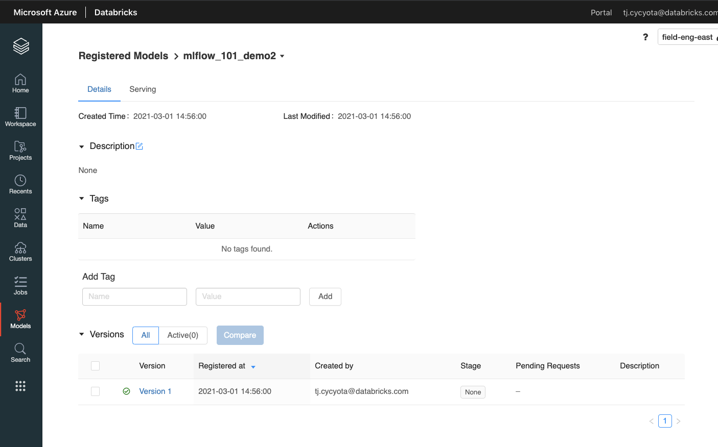
6. Model Registry
TBD
We’re on the Models tab now
We only have one version, but we can continue to iterate and tune hyperparams. CLICK into Version 1 for now

Slide 33
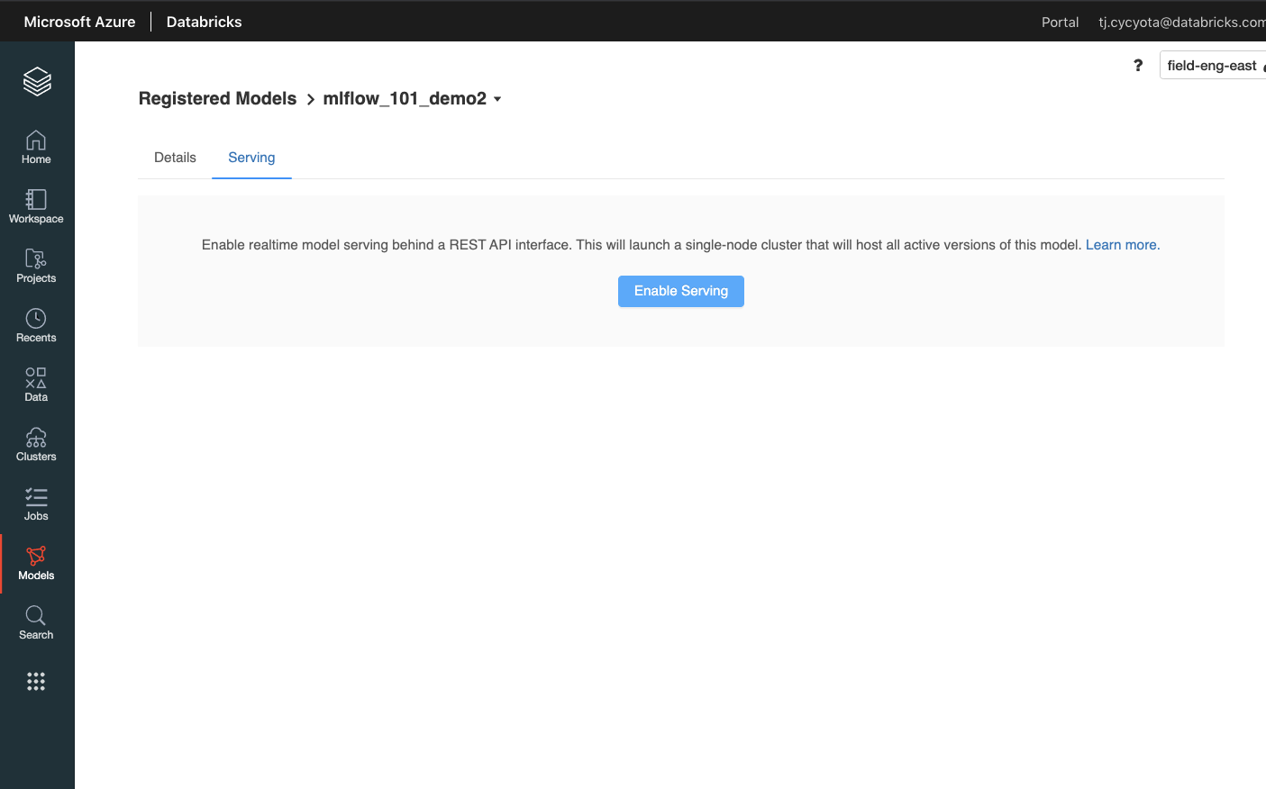
8. Back to Registered Model:
Model Serving means deploying this model as a real-time RESTful API endpoint. You can submit requests against it to get predictions on new data, and don’t have to worry about managing resources, environments, or containers.

Slide 34
Governance: MLflow Experiment Permissions
Ability | No Permissions | Can Read | Can Edit | Can Manage
View run info, search, compare runs |  | ✓. | ✓. | ✓.
View, list, and download run artifacts |  | ✓. | ✓. | ✓.
Create, delete, and restore runs |  |  | ✓. | ✓.
Log run params, metrics, tags |  |  | ✓. | ✓.
Log run artifacts |  |  | ✓. | ✓.
Edit experiment tags |  |  | ✓. | ✓.
Purge runs and experiments |  |  |  | ✓.
Grant permissions |  |  |  | ✓.

Slide 35
MLFlow Best Practices
Understand the Purpose of MLFlow: MLFlow is a platform for managing the end-to-end machine learning lifecycle. It tackles three primary functions: Experiment tracking, Reproducible runs, and Model Management.
Experiment Tracking: MLFlow allows you to track experiments, including parameters, metrics, and artifacts. This helps in comparing different runs and selecting the best model.
Reproducible Runs: MLFlow allows you to package your code, environment, and parameters in a way that makes your runs reproducible on any platform.
Model Management: MLFlow provides a centralized model registry for collaborative model lifecycle management. It allows you to register, version, and deploy models in different stages.
Integration with Databricks: MLFlow is integrated with Databricks, providing a managed tracking server and UI integration. This simplifies the process of tracking and managing ML experiments.
Use of Autologging: Autologging in MLFlow automatically logs all parameters, metrics, and artifacts, making it easier to track experiments.
Use of MLflow Pyfunc: MLflow Pyfunc is used to load MLflow models for distributed batch inference. This simplifies the process of deploying models.
Collaboration Guidelines: It's important to establish collaboration guidelines, such as logging all related MLflow runs to a shared experiment and enabling MLflow autolog for model training notebooks.
Model Registry: When a model is ready for production, it should be registered to the MLflow model registry. This helps in managing the model lifecycle.
Monitoring and Alerting: It's important to set up monitoring and alerting for your MLFlow experiments. This helps in identifying any issues early and ensuring the smooth running of your experiments.
Notes:
Edge: Faster to compute with real-time OS (C/C++)
The conservative boundary between on-the-fly and streaming computation is around 15-20 secs for more complex type of computation.

Slide 36
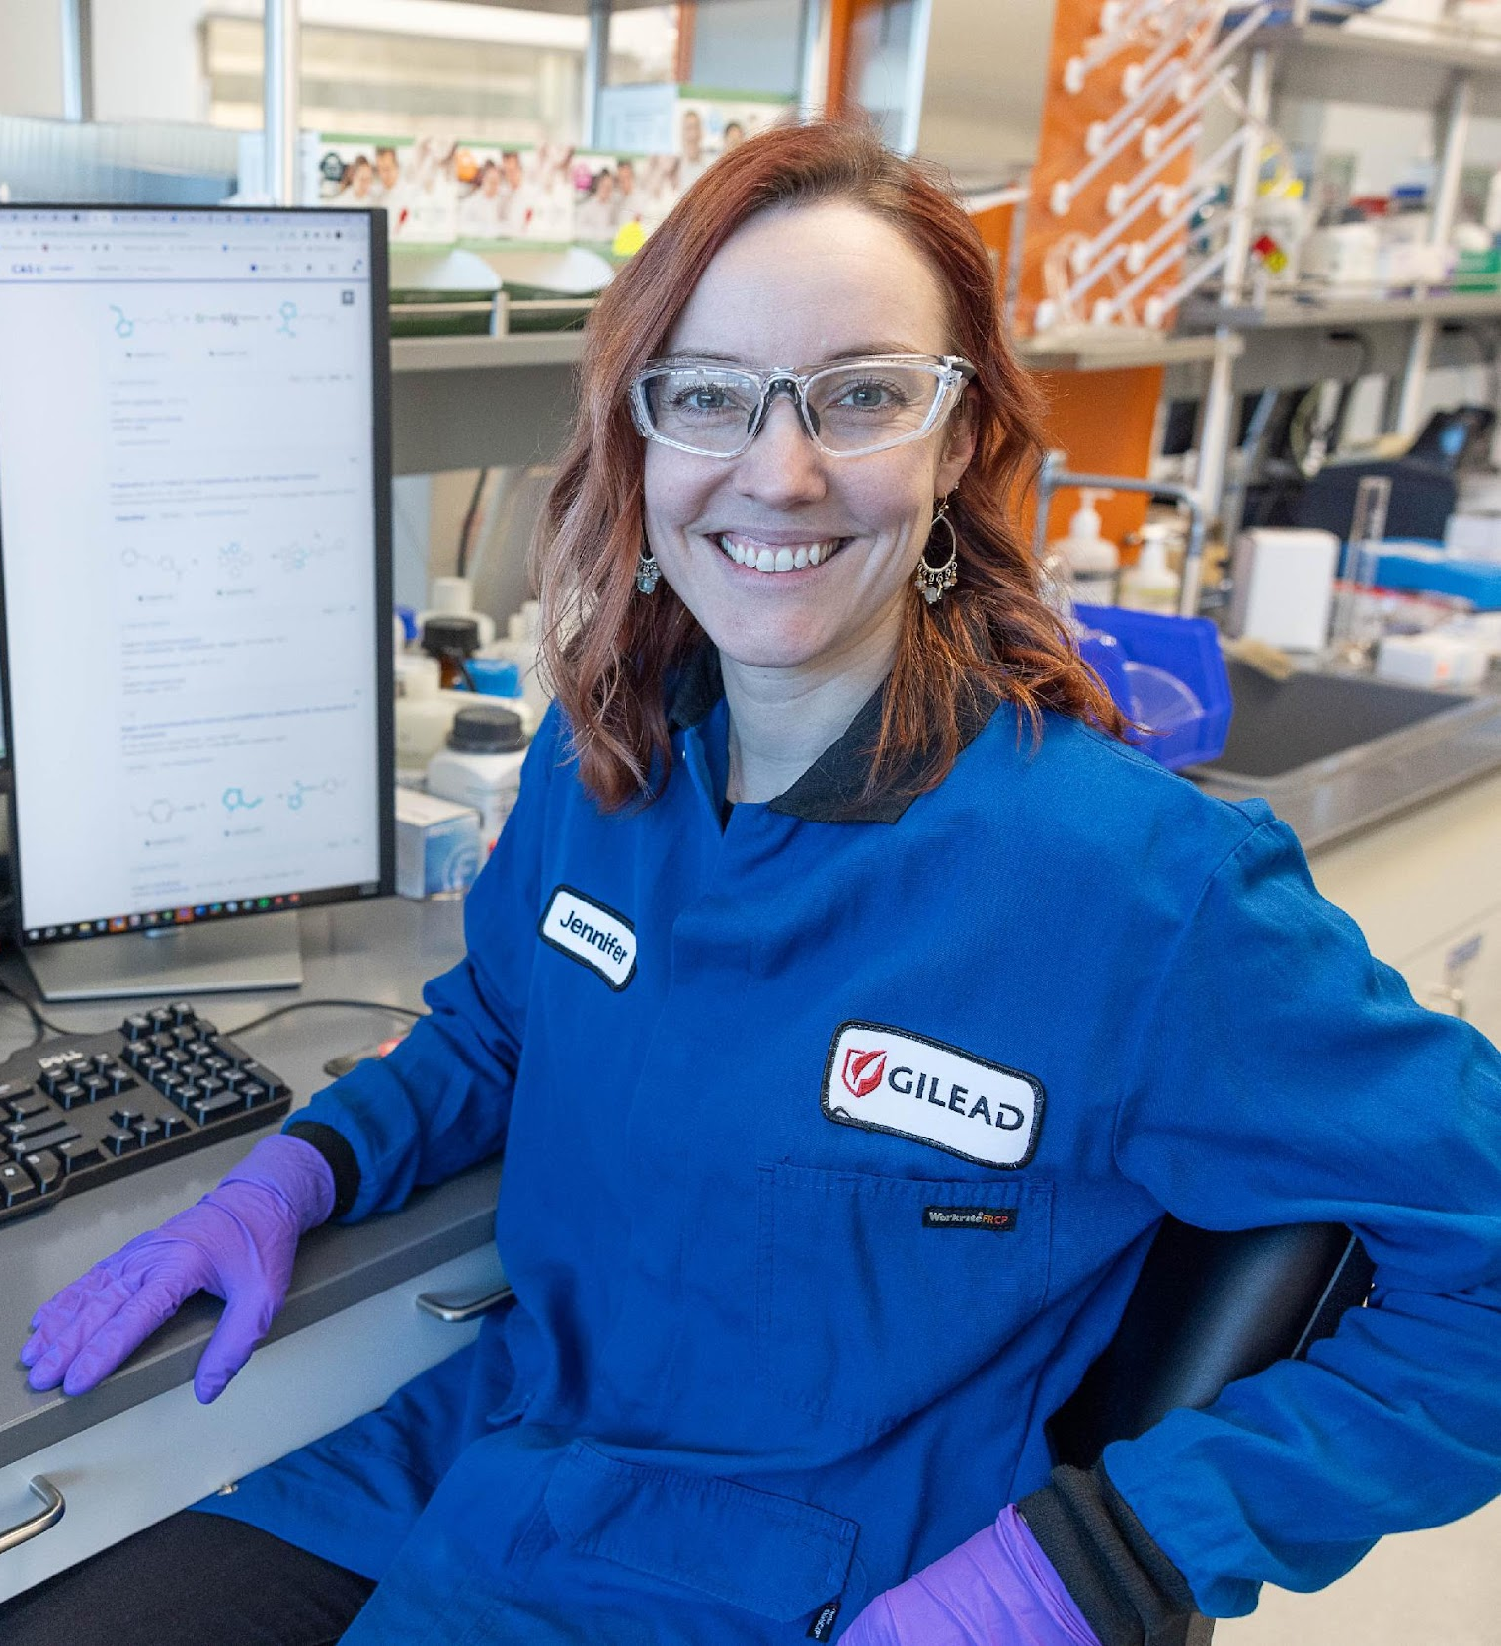
Model Registry

Slide 37




Governance for Data and AI is complex
Fragmented view of assets
Disjoint tools for security, quality, and observability
Duplicative data to enable access across environments
Stilted collaboration
Data lake
Data analyst
Data warehouse
Data engineer
ML models
ML engineer
BI dashboards
Business stakeholder

Slide 38
Tackling these challenges requires integrating your data with AI capabilities
Datasets
Models
Applications
Data Collection and Preparation
Use Existing Model or Build Your Own
Model & Data Serving and Monitoring
UNITY CATALOG
DATA PLATFORM
Notes:
One thing to note is generally is not that different from traditional machine learning methods where you come up with a dataset and train a model and you have an applications thing.
The thing that is different, however, is that traditional machine learning is more like a filter on your data, and enables you to decode meaningful features and use those features for some kind of purpose like bounding boxes and videos or you know, sentiment analysis from some sort of text.
Generative AI is different in that
You can actually take training data and produce novel outputs that are like that training data.
It is a bit of a game changer for a lot of different industries.

Slide 39
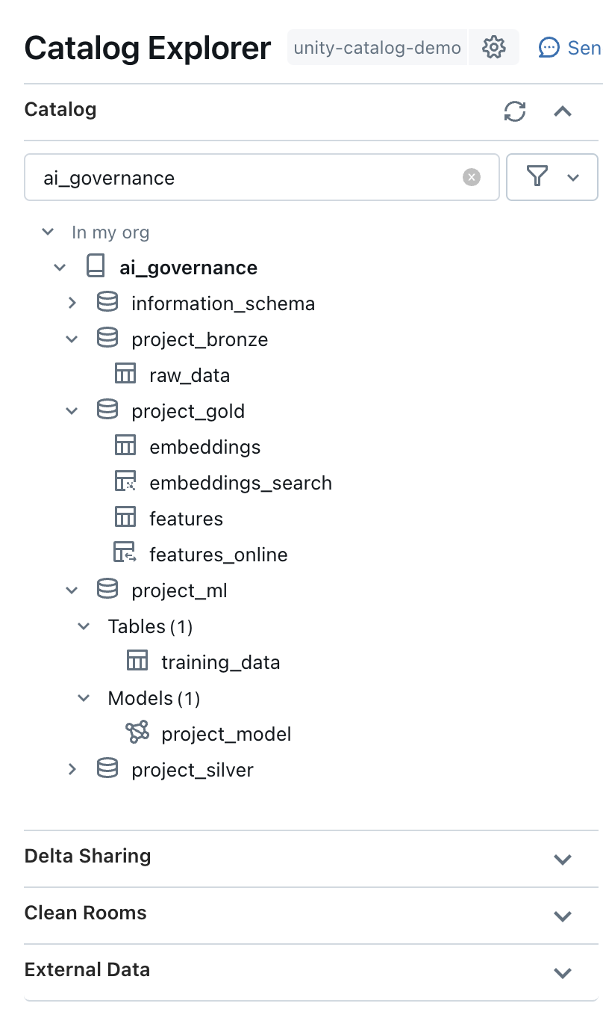
Unify governance for Data and AI
Provide cross-workspace access to data and AI assets for simpler governance & MLOps
Unity Catalog
Feature Store
features
features
features
features
features
features
data
data
Model Registry
model
data
model
model
model
model
model

Slide 40
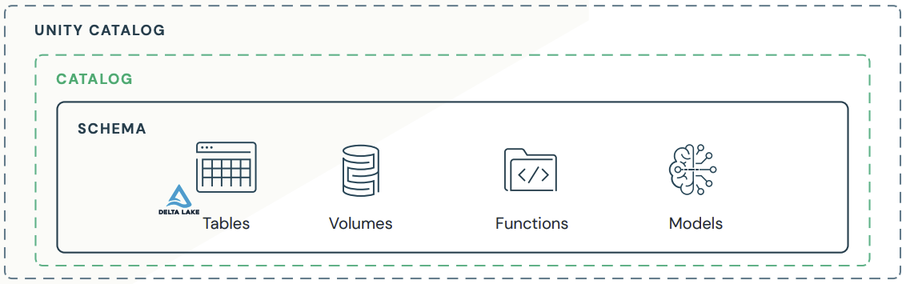
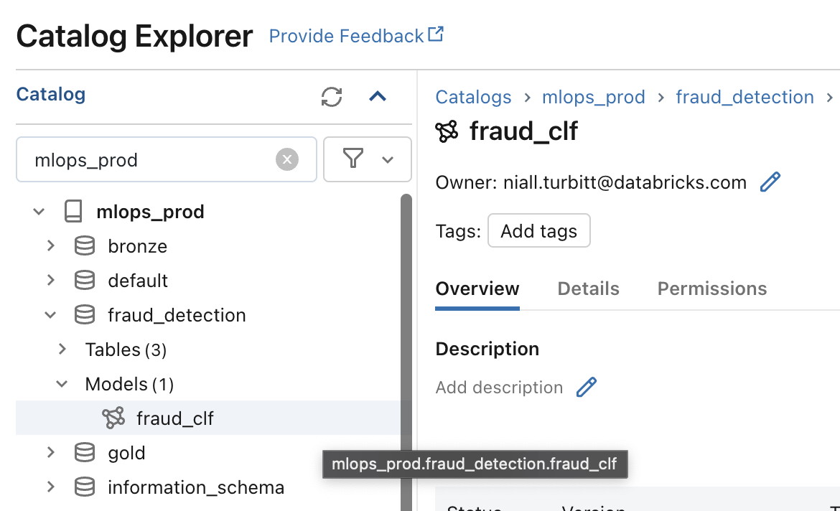
Unity Catalog
Concepts
Registered model:
An MLflow Model that has been registered to Unity Catalog.
Notes:
Registered model: An MLflow Model that has been registered to Unity Catalog. The registered model has a unique name, versions, model lineage, and other metadata. When registering a model to Unity Catalog, a three-level name is provided in the form <catalog>.<schema>.<model>.

Slide 41
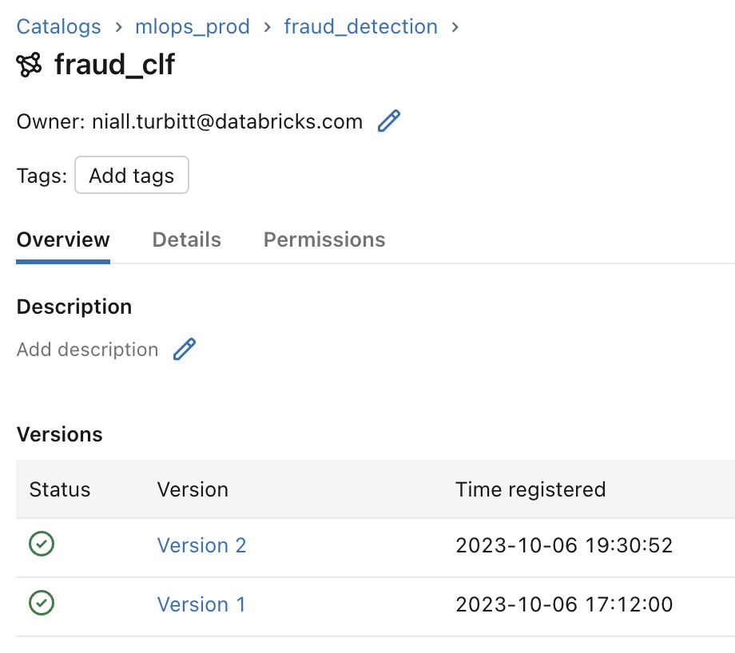
Unity Catalog
Concepts
Registered model:
An MLflow Model that has been registered to Unity Catalog.
Model version:
A version of a registered model. Each model registered to the same model name increments the version number.
Notes:
Model version: A version of a registered model. When a new model is added to the Model Registry, it is added as Version 1. Each model registered to the same model name increments the version number. A specific model version can be loaded using the model URI models:/<catalog>.<schema>.<model>/<model_version>.

Slide 42
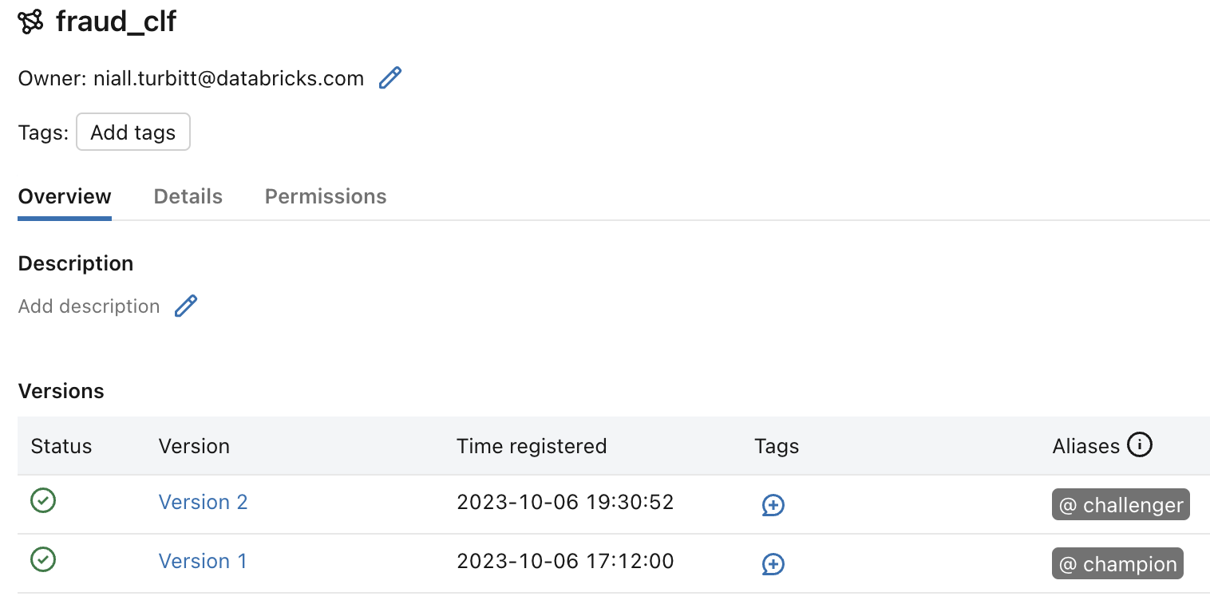
Unity Catalog
Concepts
Registered model:
An MLflow Model that has been registered to Unity Catalog.
Model version:
A version of a registered model. Each model registered to the same model name increments the version number.
Model alias:
A mutable, named reference to a particular version of a registered model.
Notes:
Model alias: A mutable, named reference to a particular version of a registered model. Typical uses of aliases are to specify which model version should be deployed in a model deployment pipeline, or to write inference workloads that target a specific alias. Aliases are flexible, and as such can be tailored to suit your use case or organization requirements. For example, you could assign the model version that should serve the majority of production traffic the “Champion” alias. Inference workloads could then target that alias using the model URI models:/<catalog>.<schema>.<model>@Champion.

Slide 43
Unity Catalog
Recommended organization - Catalog level
dev bronze silver gold fraud_detection > Tables: offline_location_features fraud_clf_inference fraud_clf_metrics > Volumes: > Models: fraud_clf > Functions: compute_distance | staging bronze silver gold fraud_detection > Tables: fraud_clf_inference fraud_clf_metrics > Volumes: > Models: fraud_clf > Functions: compute_distance | prod bronze silver gold fraud_detection > Tables: fraud_clf_inference fraud_clf_metrics > Volumes: > Models: fraud_clf > Functions: compute_distance
Notes:
Catalog level
At the catalog level, assets are segregated based on the environment from which they were produced. As a result, teams have an inherent understanding of the maturity and readiness of each asset.
dev catalog:
Assets under active development and testing. We illustrate additional tables and models within this catalog, indicative of new assets in development.
Relatively open access, enabling users to easily read and write assets during the development process.
staging catalog:
Used as an area for writing assets produced during the testing of code in the staging environment prior to deployment to the production environment.
Additionally, this catalog could also be used to store more permanent pre-production assets for the purposes of mirroring the production environment during integration testing.
Data and models stored in the staging catalog may be temporary, or cleaned up on some periodic basis.
Limited write access aside from administrators and service principals.
Read access should be enabled for users who may need to debug integration tests.
prod catalog:
Assets which have been produced using production-deployed code.
We can inherently assert that these assets have been produced by code which has been tested prior to deployment to the production environment.
Access to write to the prod catalog is typically limited to a small number of administrators or service principals.
Access to read from the prod catalog can be granted to users in non-production Databricks workspaces.

Slide 44
Unity Catalog
Recommended organization - Schema level
dev bronze silver gold fraud_detection > Tables: offline_location_features fraud_clf_inference fraud_clf_metrics > Volumes: > Models: fraud_clf > Functions: compute_distance | staging bronze silver gold fraud_detection > Tables: fraud_clf_inference fraud_clf_metrics > Volumes: > Models: fraud_clf > Functions: compute_distance | prod bronze silver gold fraud_detection > Tables: fraud_clf_inference fraud_clf_metrics > Volumes: > Models: fraud_clf > Functions: compute_distance
Notes:
Schema level
Within each catalog assets are further categorized into schemas.
bronze: Typically raw data, which is unaltered and as-is from the source.
silver: Cleaned or processed data, often transformed from raw data in bronze.
gold: Further enriched or aggregated data, ready for analysis or model training.
Tables:
Feature tables:
Tables with a primary key used to train models and serve features.
Here we illustrate how generic feature tables such as user and product features might appear under the “gold“ schema, given that such features could be shared across multiple use cases.

Slide 45
Unity Catalog
Recommended organization - Schema level
dev bronze silver gold fraud_detection > Tables: offline_location_features fraud_clf_inference fraud_clf_metrics > Volumes: > Models: fraud_clf > Functions: compute_distance | staging bronze silver gold fraud_detection > Tables: fraud_clf_inference fraud_clf_metrics > Volumes: > Models: fraud_clf > Functions: compute_distance | prod bronze silver gold fraud_detection > Tables: fraud_clf_inference fraud_clf_metrics > Volumes: > Models: fraud_clf > Functions: compute_distance
Notes:
fraud_detection: Consolidated schema for all machine learning assets relevant to the “fraud detection” use case, including (but not limited to):
Models:
Each registered model typically addresses some aspect of the schema-specific use case or project (in some cases there may be multiple models per use case).
In our example we illustrate a single registered model for the “fraud detection” use case, called “fraud_clf” (fraud classifier).
Every time a new MLflow model is registered to a given model it will produce a new incremental model version.
Aliases are then assigned to specific model versions to mark them for deployment and manage rollouts (e.g. “Champion”, “Challenger”).
Volumes:
Unstructured data (e.g. images, text) used to train models.
Tables:
Feature tables:
Feature tables created specifically for the fraud detection use case.
In the above example, we show a table called “offline_location_features'' in development under the dev catalog. This table contains historic location-based features specific to the fraud detection use case.
Inference tables:
Tables containing request-response data generated by Model Serving.
Metric tables:
Monitoring tables generated by Lakehouse Monitoring.
Functions:
Python UDFs used by models to compute features on-demand at inference time.
In our example we illustrate a “compute_distance” function which computes real-time location-based features at inference time.
Note that functions can be used in many scenarios, and not confined to just feature computation for models.

Slide 46
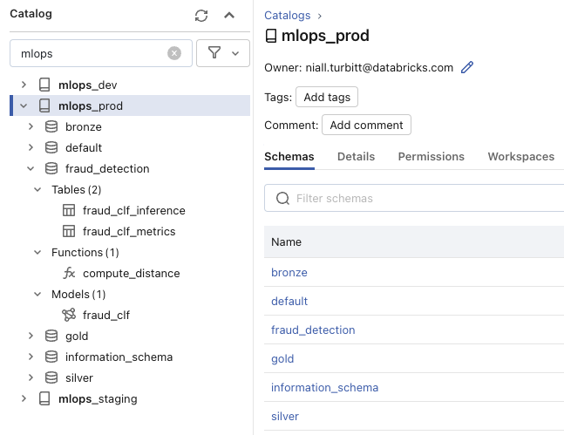
Unity Catalog
Recommended organization
dev bronze silver gold fraud_detection > Tables: offline_location_features fraud_clf_inference fraud_clf_metrics > Volumes: > Models: fraud_clf > Functions: compute_distance | staging bronze silver gold fraud_detection > Tables: fraud_clf_inference fraud_clf_metrics > Volumes: > Models: fraud_clf > Functions: compute_distance | prod bronze silver gold fraud_detection > Tables: fraud_clf_inference fraud_clf_metrics > Volumes: > Models: fraud_clf > Functions: compute_distance
Example prod catalog

Slide 47
MLFlow Model Registry Best Practices
Install MLflow Python Client: To use models in Unity Catalog on Databricks Runtime, install the latest version of the MLflow Python client in your notebook.
Configure MLflow Client to Access Models in Unity Catalog: By default, the MLflow Python client creates models in the Databricks workspace model registry. To upgrade to models in Unity Catalog, configure the MLflow client.
Deploy and Organize Models with Aliases and Tags: At the model version level, you could tag versions undergoing pre-deployment validation with validation_status:pending and those cleared for deployment with validation_status:approved.
Set and Delete Tags on Models: Both registered model and model version tags must meet the platform-wide constraints.
Load Models for Inference: Consume model versions by alias in inference workloads. You can write batch inference workloads that reference a model version by alias.
Promote a Model Across Environments: You can copy model versions across registered models in Unity Catalog to promote them across environments. After the model version is in the production environment, you can perform any necessary pre-deployment validation. Then, you can mark the model version for deployment using aliases.
Annotate a Model or Model Version: You can provide information about a model or model version by annotating it. For example, you may want to include an overview of the problem or information about the methodology and algorithm used.
Use a Central Model Registry: A dedicated Databricks workspace for a Central Model Registry is a great way to build a true MLOps process especially for enterprise customers.
Model Versioning: Automatically keep track of versions for registered models when updated.
CI/CD Workflow Integration: Record stage transitions, request, review and approve changes as part of CI/CD pipelines for better control and governance.
Notes:
Edge: Faster to compute with real-time OS (C/C++)
The conservative boundary between on-the-fly and streaming computation is around 15-20 secs for more complex type of computation.

Slide 48
HyperOpt

Slide 49
Hyperparameter Optimization
Hyperopt is a Python library that can optimize a function's value over complex spaces of inputs. It's a Bayesian optimizer, meaning it is not merely randomly searching or searching a grid, but intelligently learning which combinations of values work well as it goes, and focusing the search there.
Advantages of HyperOpt:
Bayesian optimizer - smart searches over hyperparameters (using a Tree of Parzen Estimators, FWIW), not grid or random search
Integrates with Apache Spark for parallel hyperparameter search
Integrates with MLflow for automatic tracking of the search results
Included already in the Databricks ML runtime
Maximally flexible: can optimize literally any Python model with any hyperparameters

Slide 50
HyperOpt
Hyperopt is a Python library that can optimize a function's value over complex spaces of inputs. It's a Bayesian optimizer, meaning it is not merely randomly searching or searching a grid, but intelligently learning which combinations of values work well as it goes, and focusing the search there.
Advantages of HyperOpt:
Bayesian optimizer - smart searches over hyperparameters (using a Tree of Parzen Estimators, FWIW), not grid or random search
Integrates with Apache Spark for parallel hyperparameter search
Integrates with MLflow for automatic tracking of the search results
Included already in the Databricks ML runtime
Maximally flexible: can optimize literally any Python model with any hyperparameters

Slide 51
Tree of Parzen Estimators (TPE)
Sequential optimization algorithm
Uses previous trials to suggest value for next trial
Input: hyperparameter values and evaluation metrics
Output: suggested hyperparameter value for next trial
Suggests to maximize expected improvement by estimating the relationship between previous inputs and metrics
Applies to each hyperparameter independently

Slide 52
Parallelizing TPE
E1
Data
Model Trial #1
Model Trial #5
Model Trial #8
E2
Data
Model Trial #2
Model Trial #6
E3
Data
Model Trial #3
Model Trial #7
E4
Data
Model Trial #4

Slide 53

Using Hyperopt
Prepare data as normal
Create objective function
Define the search space
Call the fmin operation

Slide 54
Hyperopt Best Practices
Efficient Search Algorithm: Hyperopt uses the Tree of Parzen Estimators (TPE) algorithm, which is more efficient than grid search and random search. This allows you to explore more hyperparameters and larger ranges. Using domain knowledge to restrict the search domain can optimize tuning and produce better results.
Parameter Logging: When you use hp.choice(), Hyperopt returns the index of the choice list. Therefore the parameter logged in MLflow is also the index. Use hyperopt.space_eval() to retrieve the parameter values.
Experiment with Small Datasets: For models with long training times, start experimenting with small datasets and many hyperparameters. Use MLflow to identify the best performing models and determine which hyperparameters can be fixed. This way, you can reduce the parameter space as you prepare to tune at scale.
Use of Conditional Dimensions and Hyperparameters: Hyperopt supports conditional dimensions and hyperparameters. This can be particularly useful when evaluating multiple flavors of gradient descent.
Avoid SparkTrials on Autoscaling Clusters: Hyperopt selects the parallelism value when execution begins. If the cluster later autoscales, Hyperopt will not be able to take advantage of the new cluster size. Therefore, it's recommended not to use SparkTrials on autoscaling clusters.
Notes:
Edge: Faster to compute with real-time OS (C/C++)
The conservative boundary between on-the-fly and streaming computation is around 15-20 secs for more complex type of computation.

Slide 55
Feature Selection SDK

Slide 56
AutoGluon SDK

Slide 57
Divider Slide with Image

Slide 58
Divider Slide with Image

Slide 59
This is a Single-Column Content Slide
This is for slide content. The main type size is 20pt, and type will not resize if the amount of content on the slide surpasses the space available. Please use the global font size adjustment next to the numerical font size selector to decrease font size across the entire text area.
This is a bullet style
This is a sub-bullet
This is a third level bullet

Slide 60
This is a Single-Column Content Slide
This is for slide content. The main type size is 20pt, and type will not resize if the amount of content on the slide surpasses the space available. Please use the global font size adjustment next to the numerical font size selector to decrease font size across the entire text area.
This is a bullet style
This is a sub-bullet
This is a third level bullet

Slide 61
This is a Two-Column Content Slide
This is for slide content
Bullet style example
This is a sub-bullet
This is a third level bullet
This is for slide content
Bullet style example
This is a sub-bullet
This is a third level bullet

Slide 62
This is a Three-Column Content Slide
This is for slide content
Bullet style example
This is a sub-bullet
This is a third level bullet
This is for slide content
Bullet style example
This is a sub-bullet
This is a third level bullet
This is for slide content
Bullet style example
This is a sub-bullet
This is a third level bullet

Slide 63
Content + Infographic
Cell 1 | Cell 2 | Cell 3 | Cell 4
Put table content here. | Put table content here. | Put table content here.
Put table content here.
This slide is for copy on the left & some sort of supporting graphical image or photo on the right-hand side.

Slide 64
Content + Infographic
Cell 1 | Cell 2 | Cell 3 | Cell 4
Put table content here. | Put table content here. | Put table content here.
Put table content here.
This slide is for copy on the left & some sort of supporting graphical image or photo on the right-hand side.

Slide 65
Place Headline Here
This is a side-by-side content slide – it provides an option for simpler slide content.
You can put a few points of body copy in here and the text area will expand from the center to fill the content space.

Slide 66
Place Headline Here
This is a side-by-side content slide – it provides an option for simpler slide content.
You can put a few points of body copy in here and the text area will expand from the center to fill the content space.

Slide 67
This is a key point example. Text only.

Slide 68
This is a key point example. Text only.

Slide 69
This is a key point example. Text only.

Slide 70
This is a key point example. Text only.

Slide 71
This is a key point example. Text only.

Slide 72
This is a key point example. Text only.

Slide 73
This is a key point.
You can compare two things.

Slide 74
This is a key point.
You can compare two things.

Slide 75
Key point + add custom image

Slide 76
Full Page Image with Large Call Out

Slide 77
Full Page Image with Large Call Out

